Slide 1
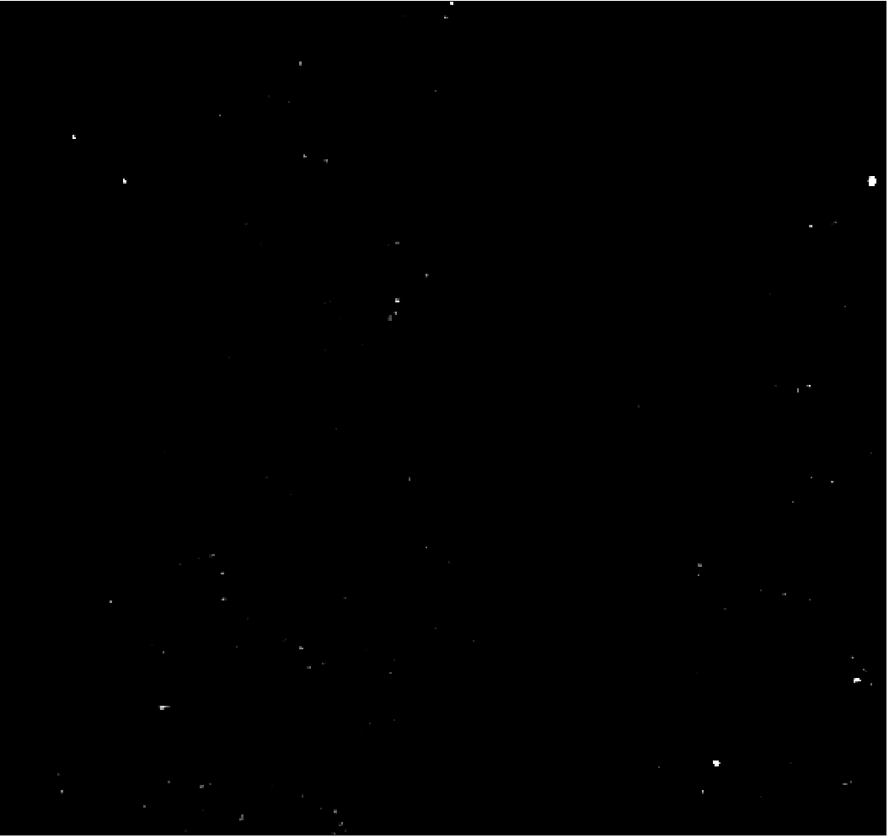
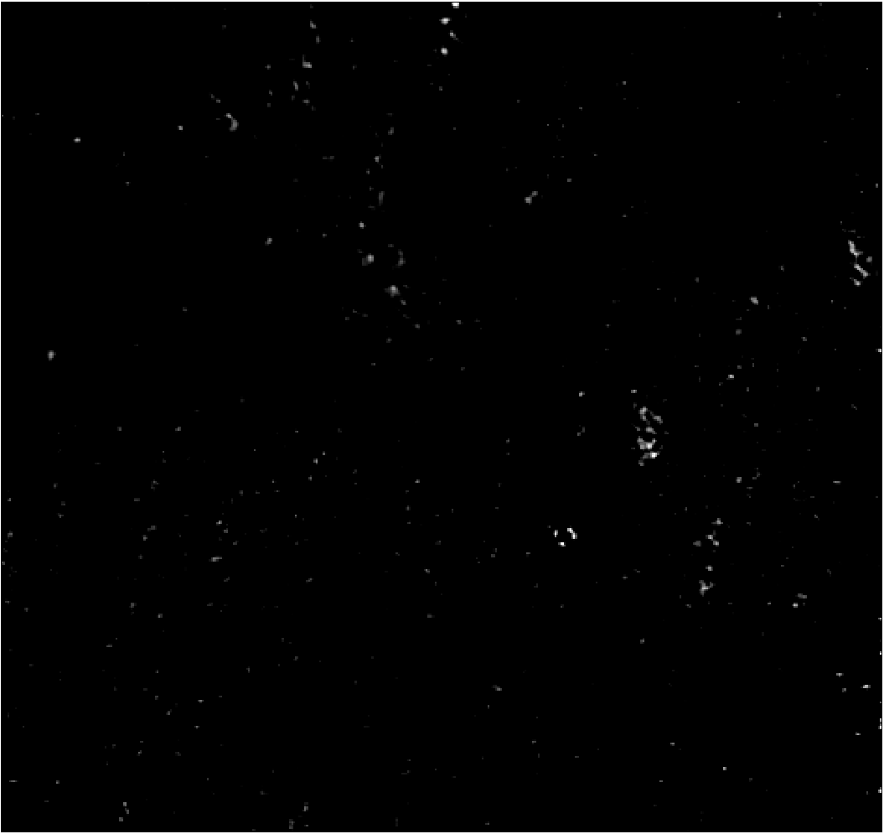
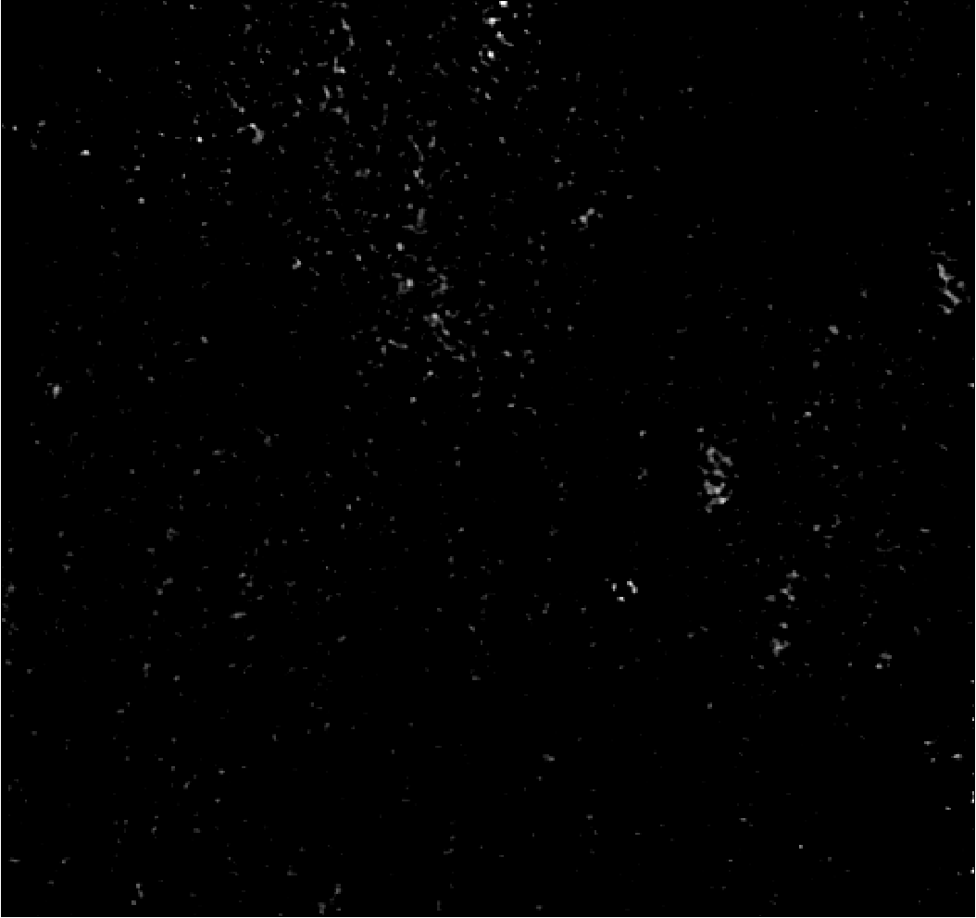
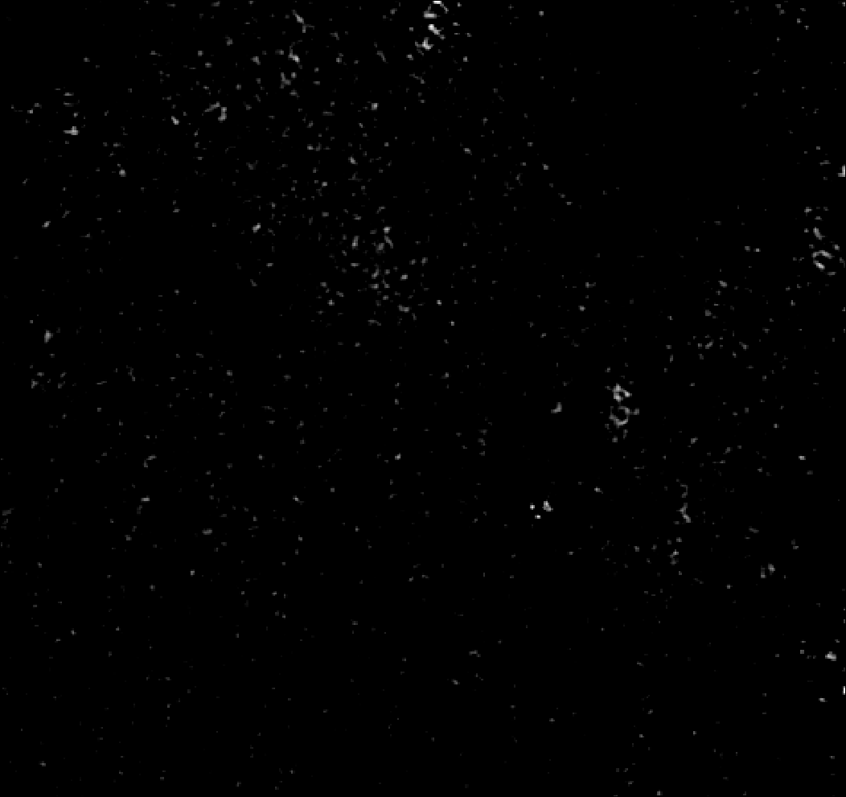
H460 exosomes detected via PANORAMA
PANORAMA
Time: 60 min
Count:160
PANORAMA
Time: 60 min
Count:560
PANORAMA
Time: 60 min
Count:1597
PANORAMA
Time: 60 min
Count:1520
95 % of exosomes detected via PANORAMA at time 90 min were captured
Scale bar: 5 µm

Slide 2
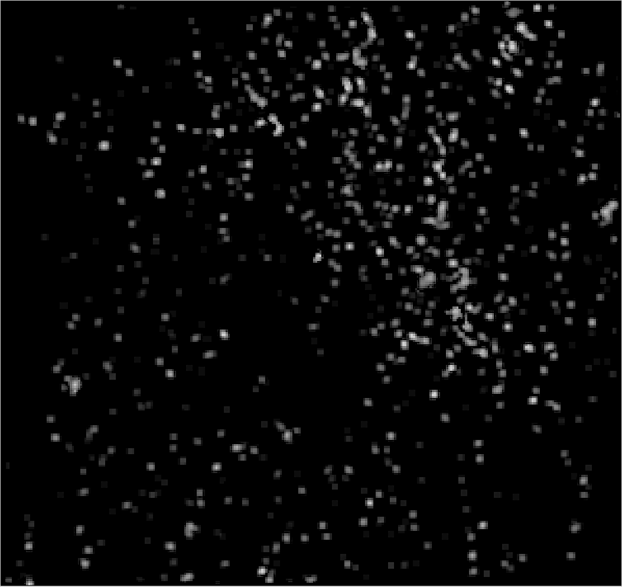
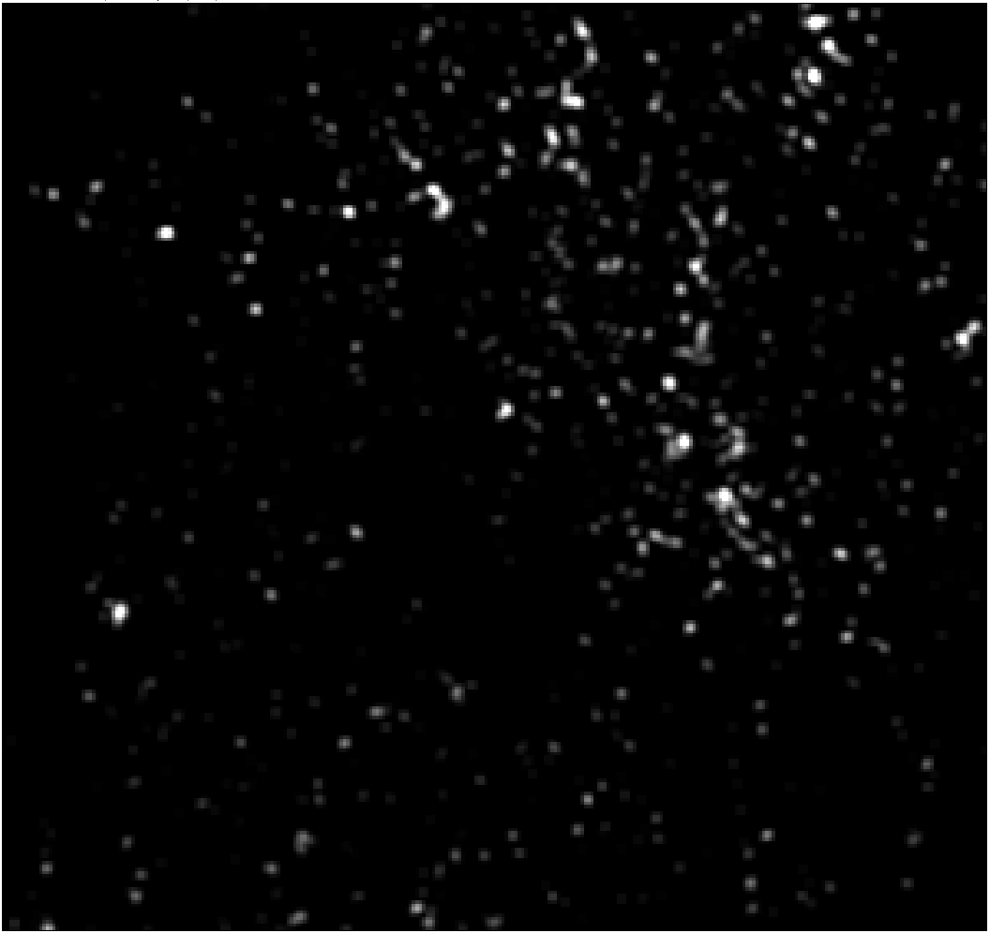
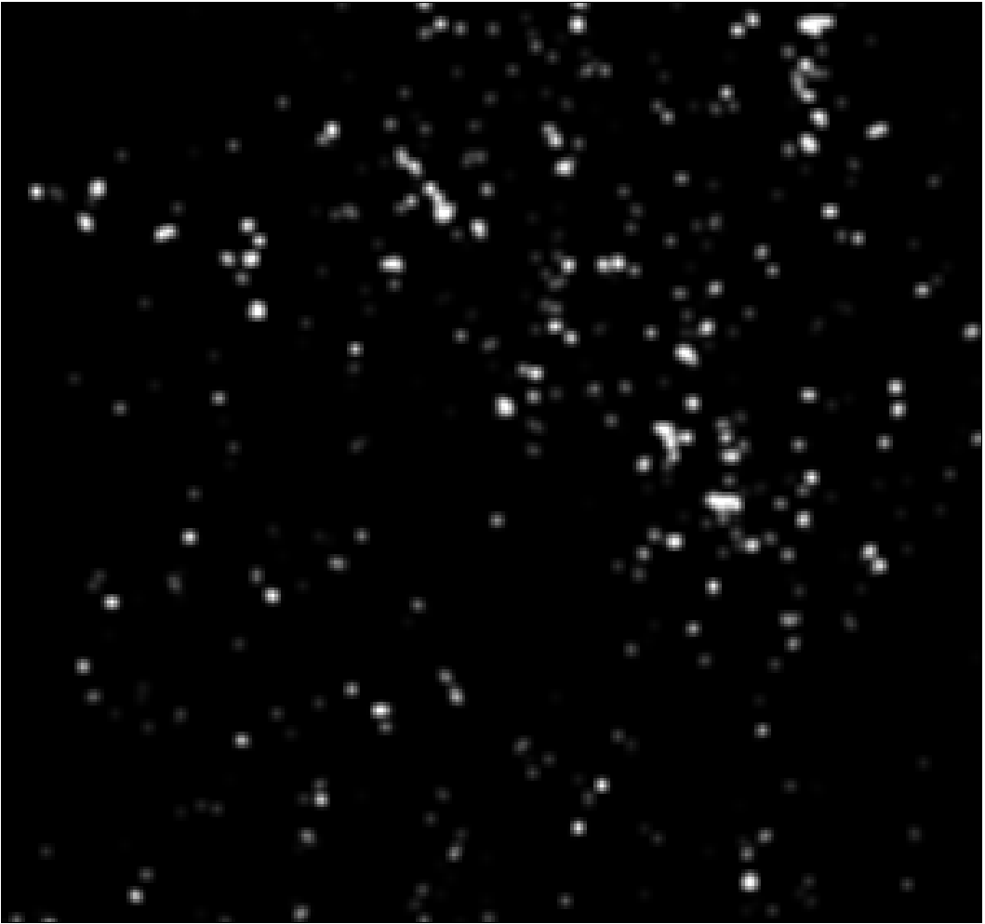
H460 exosomes detected via PANORAMA and Fluorescence
PANORAMA (1.1±0.03)
Time: 90 min Wash
Count: 525
Fluorescence (408±78)
Time: 90 min Wash
Count: 368
70 % of exosomes detected via PANORAMA showed mir-21 positive fluorescence
Scale bar: 5 µm

